Slide 1
DevOps 101 for the IT Admin
Joe Houghes

Slide 2

Many thanks to our sponsors:

Slide 3

Joe Houghes
Senior Solutions Architect, Pure Storage
PowerShell & VMware User Group Leader
Veeam Vanguard
VMware vExpert (Pro)
Cisco Champion
Tanzu Vanguard

Slide 4
PowerShell, PowerCLI, API Don’t forget the PowerShell basics
Get-Help is your friend; make your life easier
PowerShell — Built for pipeline; embrace & use it
Stack cmdlets & results like Lego (Buy a set if you are outdated on the concept)
Forget what your teachers told you… Cheat/look up the answer whenever possible

Slide 5
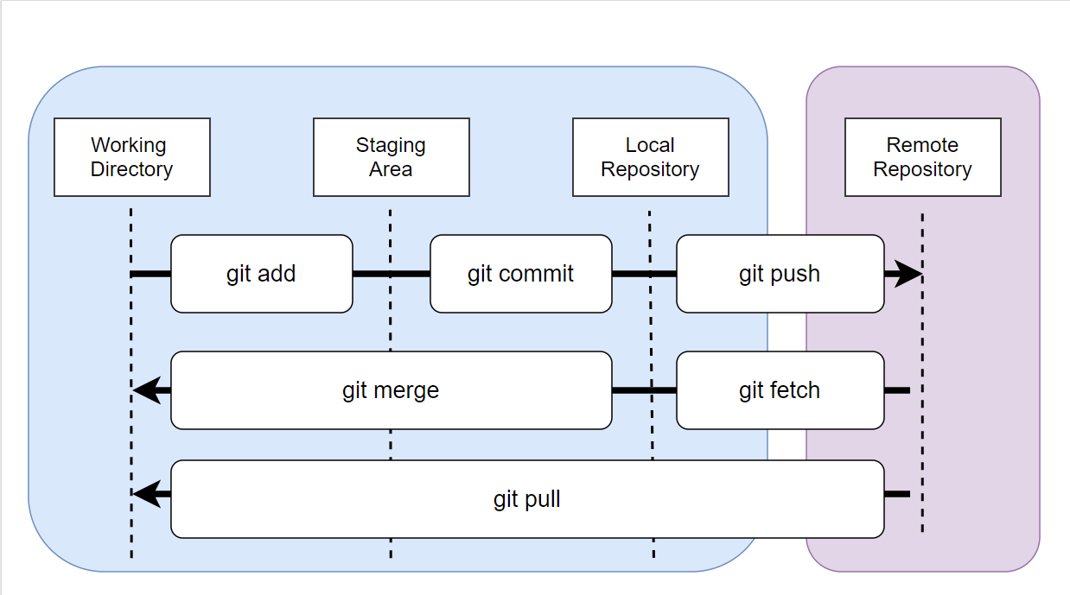
Git
(Flow)

Slide 6
Packer
Open-source Infrastructure as Code (IaC) tool
Building of automated machine images
Hashicorp Configuration Language (HCL)
Multiple platform builds from config
Variable files – automatic & defined

Slide 7
Terraform
Open-source Infrastructure as Code (IaC) tool
Consistent CLI workflow
Hashicorp Configuration Language (HCL)
Declarative config files
Providers for resource dependencies
State files – resource map

Slide 8
Ansible
Automation framework - relies on SSH & Python
Controller machine
Inventory for managed devices (not facts)
Playbook, module, task
Role for multi-playbook/files
Play – provision executer begin to end

Slide 9
Demos
We love Demos!

Slide 10
Q&A
15 minutes

Slide 11
Resources
Git:
https://git-scm.com/docs
https://git-scm.com/book/en/v2
Packer/Terraform /Ansible Example
https://github.com/vmware-samples/packer-examples-for-vsphere
Used in Demos:
‘Show-Object’ (PowerShellCookbook module - PSGallery)

